Slide 1
Temporal Graph Networks lecture-10 Course on Graph Neural Networks (Winter Term 20/21)
Christian Medeiros Adriano (christian.adriano@hpi.de) - “Chris”
Max Schumacher (schumacher2@uni-potsdam.de)
Sona Ghahremani (sona.ghahremani@hpi.de )
Prof. Dr. Holger Giese (holger.giese@hpi.de)

Slide 2
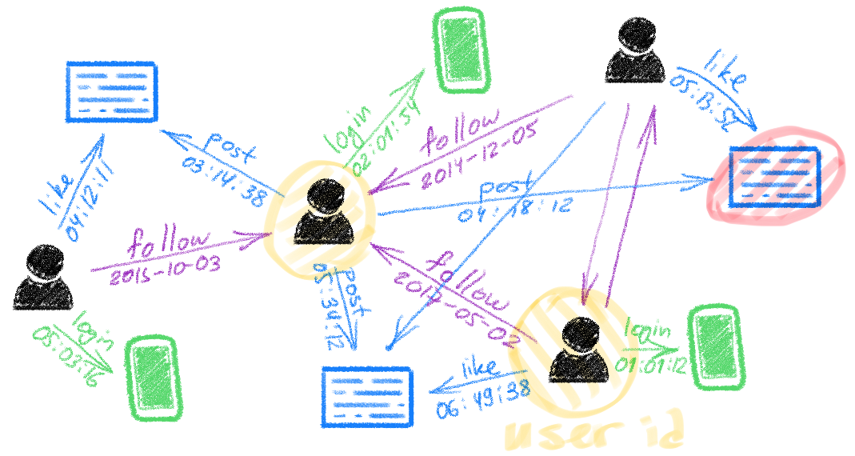
Time in Networks
Nodes and edges of certain networks change over time
Twitter
News Comments
Traffic
source: Bronstein, M., Graph ML at Twitter, 2020
https://blog.twitter.com/engineering/en_us/topics/insights/2020/graph-ml-at-twitter.html
Notes:
source: Bronstein, M., Graph ML at Twitter, 2020
https://blog.twitter.com/engineering/en_us/topics/insights/2020/graph-ml-at-twitter.html

Slide 3
Quick recap – Where are we now?
Graph Metrics and Random Models
Graph Classification - Clustering
Graph Sampling - Random Walks
Graph Embeddings - Message Passing
PageRank
Graph Structure Learning
Graph Convolutional Networks
Graph Attention Networks
Graph Evolution Networks
Temporal Graph Networks
Graph Generative Models (and Graph Neural ODE)
Network Effects, Cascading and Contagion
Outbreak Detection in Networks
Influence Maximization in Networks
Design concerns
Understand a phenomenon
Extract features
Stablish baselines
Preprocessing data
Description models
Predict an outcome
ML architecture and pipeline
Training models
Evaluation models
Prediction models
Effects of interventions
Risks of confounding
Causal structure
Intervention models
Notes:
[Wang & Tax 2016] Wang, Feng, and David MJ Tax. "Survey on the attention based RNN model and its applications in computer vision." arXiv preprint arXiv:1601.06823 (2016).
[Luong et al. 2015] Luong, Minh-Thang, Hieu Pham, and Christopher D. Manning. "Effective approaches to attention-based neural machine translation." arXiv preprint arXiv:1508.04025 (2015).
[Vaswani et al. 2017] Vaswani, A., Shazeer, N., Parmar, N., Uszkoreit, J., Jones, L., Gomez, A. N., ... & Polosukhin, I. (2017). Attention is all you need. Advances in neural information processing systems, 30, 5998-6008.
Bahdanau, Dzmitry, Kyunghyun Cho, and Yoshua Bengio. "Neural machine translation by jointly learning to align and translate." arXiv preprint arXiv:1409.0473 (2014).
Xu, Kelvin, et al. "Show, attend and tell: Neural image caption generation with visual attention." International conference on machine learning. 2015.
The research described in the paper Graph Convolutional Network (GCN), indicates that combining local graph structure and node-level features produces good performance on node classification tasks. However, the way GCN aggregates is structure-dependent, which can hurt its generalizability.
One workaround is to simply average over all neighbor node features as described in the research paper GraphSAGE. However, Graph Attention Network proposes a different type of aggregation. GAN uses weighting neighbor features with feature dependent and structure-free normalization, in the style of attention.

Slide 4
Why do we need Temporal Graph Networks?
Time is a feature of nodes, edges, and graphs
Frequent versus stale relationships
Similarity or clustering w.r.t. time
Time itself is a characteristic to be predicted
Probability of new links in time
Network events (contagion, influence) in time

Slide 5
Brief (incomplete) historical perspective -1
2000’s – Measuring network evolution phenomena
Growth dynamics of the world-wide web [Huberman & Adamic 1999]
Graphs over time densification laws, shrinking diameters and possible explanations [Leskovec et al. 2005]
The dynamics of viral marketing [Leskovec, Adamic & Huberman 2007]
2010’s – Generative models for network evolution
Kronecker graphs an approach to modeling networks [Leskovec et al. 2010]
Emerging topic detection on twitter based on temporal and social terms evaluation [Cataldi et al. 2010]
Collaboration over time characterizing and modeling network evolution [Huang et al. 2012]

Slide 6
Brief (incomplete) historical perspective -2
2020’s – Prediction models of network evolution
Spectral Networks and Deep Locally Connected Networks on Graphs [Bruna et al. 2014]
Semi-supervised classification with graph convolutional networks [Kipf & Welling 2017]
Temporal Graph Neural Networks [Rossi et al. 2020]
Spectral Temporal Graph Neural Network for Multivariate Time-series Forecasting [Cao et al. 2020]
Evolvegraph: Multi-agent trajectory prediction with dynamic relational reasoning [Li et al. 2020]
Notes:
Kipf, T. N. & Welling, M., "Semi-supervised classification with graph convolutional networks." ICRL, 2017

Slide 7
Index
Discrete to Continuous Time - Temporal Graph Neural Network (Chris)
Space and Time (Max)
Spacio-Temporal Convolution
Diffusion Convolution Recurrent Networks (GRU cell idea)
Recurrent Neural Networks
Graph Convolution Networks with Kalman Filtering for Traffic Prediction
Multi-Head Attention (some example)
Spectral Convolution (Chris)
Spectral Networks (short intro)
Spectral Temporal Graph Neural Network
Innovative Architectures:
EvolveGraph – Latent Graph Model (Chris)
ST-UNet: A Spatio-Temporal U-Network for Graph-structured Time Series Modeling (Max)

Slide 8
From discrete time (recap) to continuous time

Slide 9
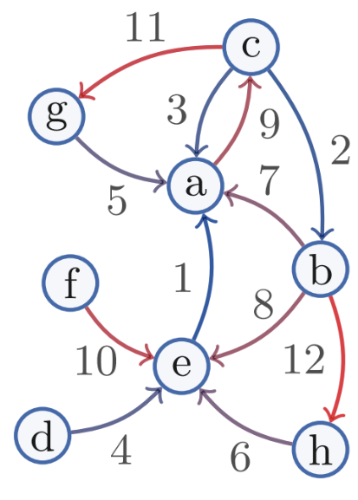
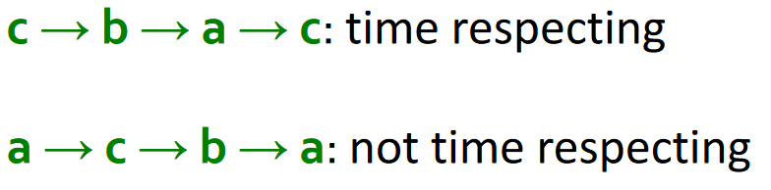
Temporal Page Rank
Goal: Make a random walk only on temporal or time-respecting paths
Intuition: Run a regular PageRank on a time-augmented graph
Time stamps increase along the path
Edge timestamps
https://web.stanford.edu/class/cs224w/slides/16-evolution.pdf

Slide 10
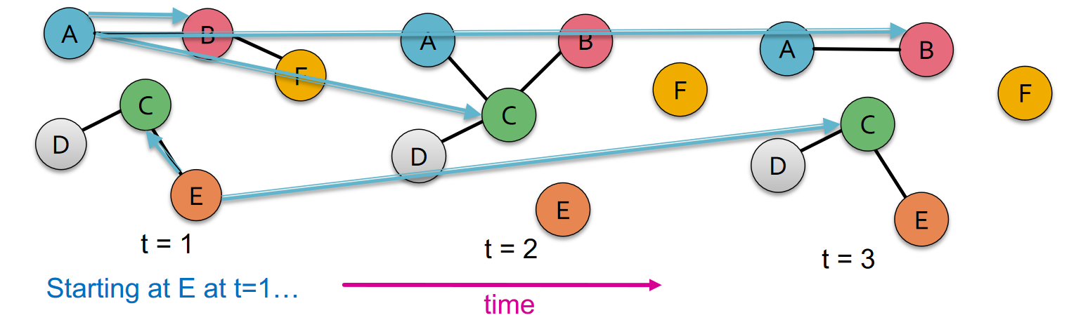
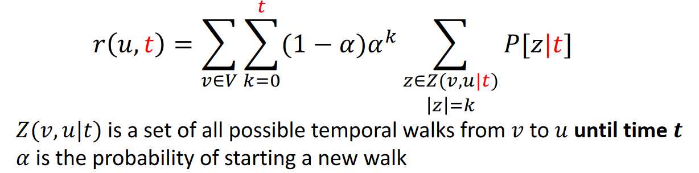
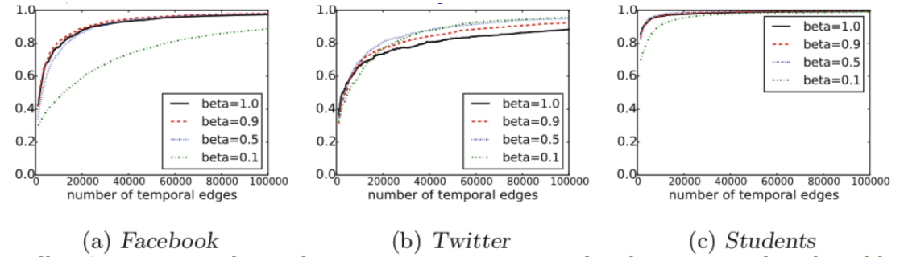
Temporal PageRank – Augmented Graph
Rank quality (Pearson corr. coeff. Between static and temporal PageRank) and transition probability 𝜷
𝑟(𝑢): Temporal PageRank estimate of 𝑢
Smaller 𝜷 corresponds to slower convergence rate, but better correlated rankings
10
https://web.stanford.edu/class/cs224w/slides/16-evolution.pdf
Notes:
Rank quality (Pearson corr. coeff. Between static and temporal PageRank) and transition probability 𝜷
Smaller 𝜷corresponds to slower convergence rate, but better correlated rankings

Slide 11
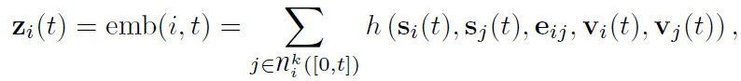
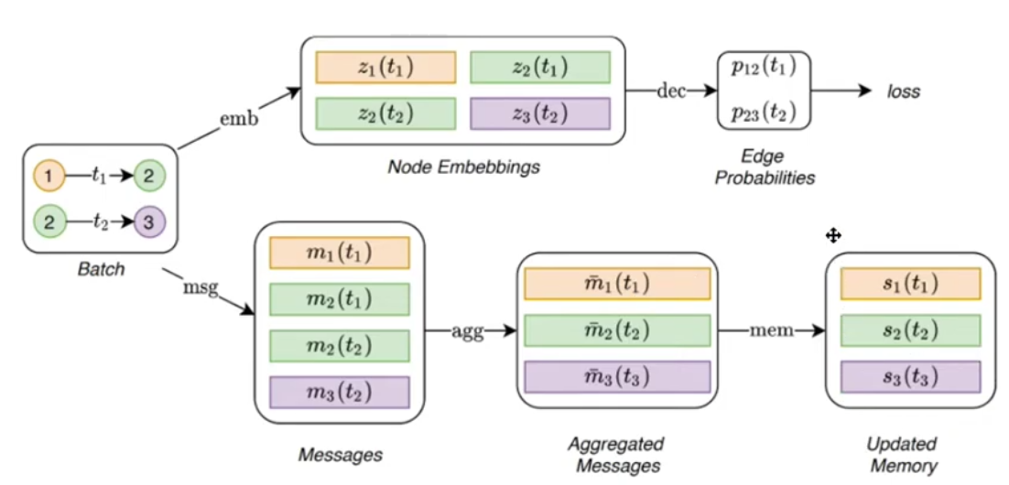
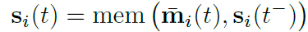
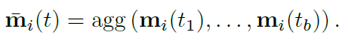
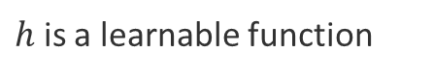
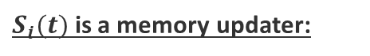
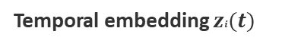
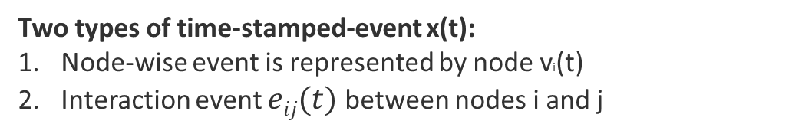
Temporal Graph Neural Networks [Rossi et al. 2020]
Goal: predict next node link in a Twitter network
Intuition: Temporal Graph Network (TGN) encoder applied on a continuous-time dynamic graph
Two types of time-stamped-event x(t):
Node-wise event is represented by node vi(t)
Interaction event $eij(t)$ between nodes i and j
Neural Dynamic Graph [Kazemi et al.,2020]
encoder maps from a dynamic graph to node embeddings
decoder takes as input one or more node embeddings and makes a task-specific prediction, e.g., node classification or edge prediction.
Temporal embedding $zi(t)$
$h$ is a learnable function
Core Modules
$S_{i}(t)$ is a memory updater:
source: Rossi et al. (2020) Temporal Graph Neural Networks, NeurIPS.
LSTM or RNN
Notes:
[Kamezi et al. 2020] Seyed Mehran Kazemi, Rishab Goel, Kshitij Jain, Ivan Kobyzev, Akshay Sethi, Peter Forsyth, and
Pascal Poupart. Representation learning for dynamic graphs: A survey. Journal of Machine Learning Research, 21(70):1–73, 2020. URL http://jmlr.org/papers/v21/19-447.html

Slide 12
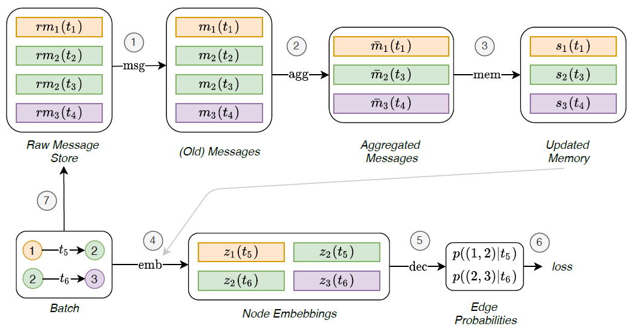
Flow of the TGN operation [Rossi et al. 2020]
Goal: Allows the computation of the memory-related modules to directly influence the loss
embeddings can be computed using the just updated memory
source: Rossi et al. (2020) Temporal Graph Neural Networks, NeurIPS

Slide 13
Spatio-Temporal Graph Networks

Slide 14
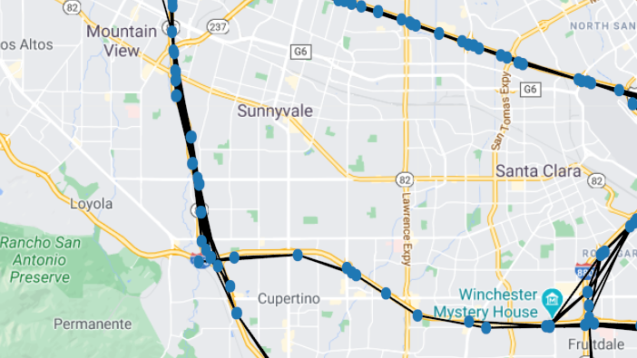
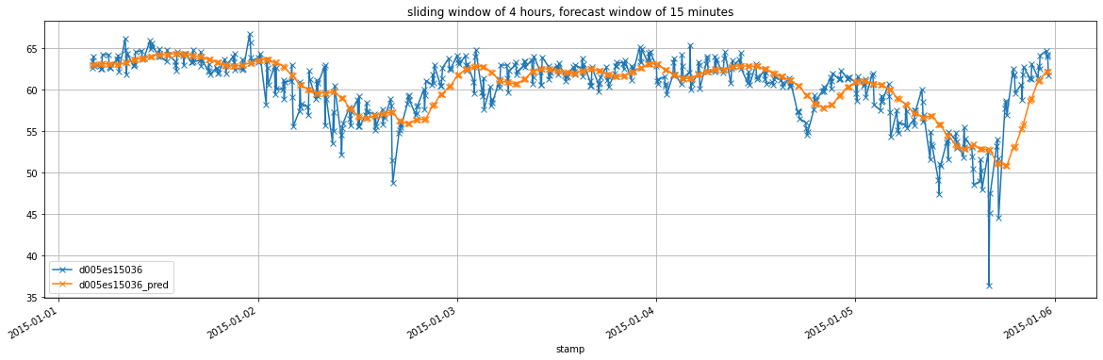
Spatio-Temporal Graph Problem: Traffic Prediction
$$\left[X^{\left(t−M+1\right)}, …, X^{t}\right] → \left[X^{t},…,X^{t+H}\right]$$
Space
Time
Signal of #N Nodes at time k: $X^{k}∈{\text{ℝ}}^{N}$
Time

Slide 15
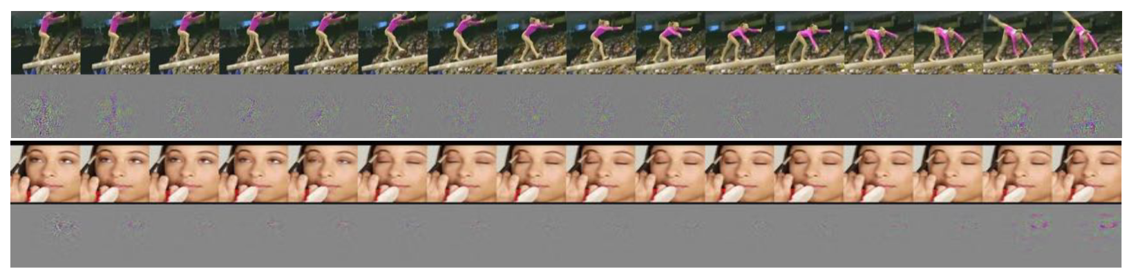
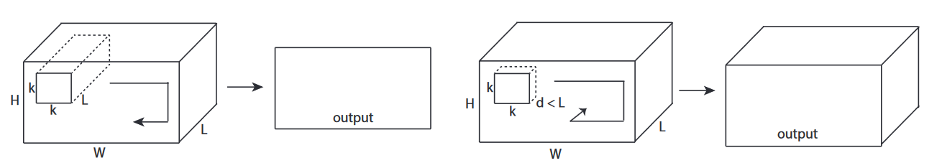
Learning Spatiotemporal Features with 3D Conv
Action classification with 3D convolution + linear classifier
2D convolution treats time as channels
2D convolution collapses time dimension in 1 convolution step → information loss
3D convolution goes from volume to volume by moving a 3D Kernel
D. Tran, L. Bourdev, R. Fergus, L. Torresani and M. Paluri, "Learning Spatiotemporal Features with 3D Convolutional Networks," 2015 IEEE International Conference on Computer Vision (ICCV)

Slide 16
How to do 3D Convolution on Graphs?
Recall: spectral convolution
$y=g_{θ}\left(UΛU^{T}\right)x=Ug_{θ}\left(Λ\right)U^{T}x$ with $g_{θ}\left(Λ\right)=diag(θ)$
Transform to spectral domain
Convolve by multiplication
Approximate by “Chebyshev Polynomials“
$$\sum_{k=0}^{K−1}{θ_{k}T_{k}\left(L\right)x}$$
Idea: generalized spectral convolution
$${{\hat{X}}^{t}}_{C_{o}}=\sum_{i=1}^{C_{i}}{\sum_{t^{′}=0}^{K_{t}−1}{\sum_{k=0}^{K−1}{θ_{i,C_{0},k,t^{′}}}}}T_{k}\left(L\right)X_{i}^{t−t^{′}}$$
convolution
$$(M) layers$$
$$(M−K_{t}+1) layers$$
Yu, Bing, et al. "3d graph convolutional networks with temporal graphs: A spatial information free framework for traffic forecasting." arXiv preprint arXiv:1903.00919 (2019).

Slide 17
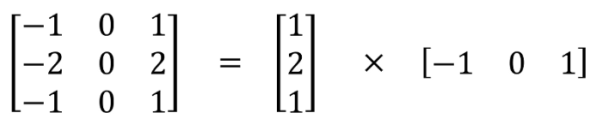
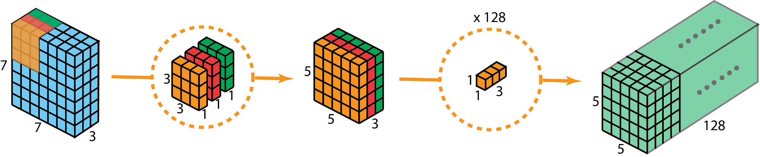
Pseudo 3D Convolution- 1
Motivation:
3D Convolution has lots of parameters
Is not directly applicable to all types of graph convolution
Idea:
separate 3x3x3 convolution into 3x3x1 and 1x1x3 convolution
Assumption:
3D convolution is separable
https://towardsdatascience.com/a-comprehensive-introduction-to-different-types-of-convolutions-in-deep-learning-669281e58215
Qiu, Zhaofan, Ting Yao, and Tao Mei. "Learning spatio-temporal representation with pseudo-3d residual networks." proceedings of the IEEE International Conference on Computer Vision. 2017.

Slide 18
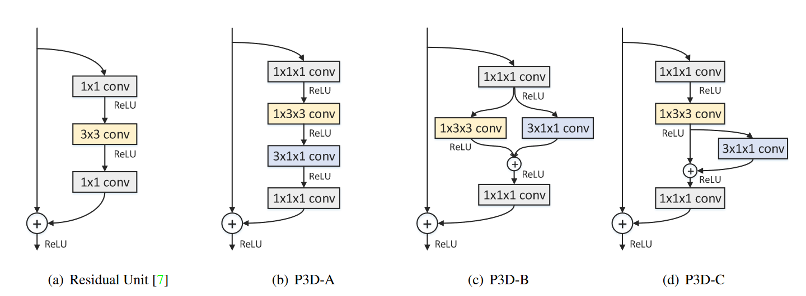
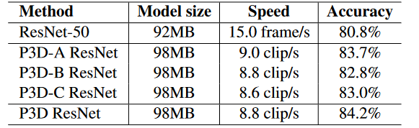
Learning Spatio-Temporal Representation with P3D
Use any “2D” Graph convolution (S)
Use any variant of 1D convolution (T) over time that fits input dimension
Combine variants (a), (b) and (c)
Qiu, Zhaofan, Ting Yao, and Tao Mei. "Learning spatio-temporal representation with pseudo-3d residual networks." proceedings of the IEEE International Conference on Computer Vision. 2017.

Slide 19
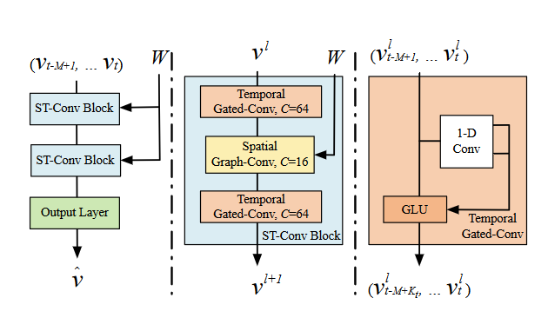
2D + 1D Architectures - Spatio-Temporal GCNs
Pseudo 3D architecture is very flexible: Any 2D Graph Convolution + 1D Convolution over time
Input: signal at time $l$: $V^{l}$
Output: prediction at time $l+1$
→ Use any “2D” Graph convolution +1D convolution over time-axis
Yu, Bing, Haoteng Yin, and Zhanxing Zhu. "Spatio-temporal graph convolutional networks: A deep learning framework for traffic forecasting." arXiv preprint arXiv:1709.04875 (2017).

Slide 20
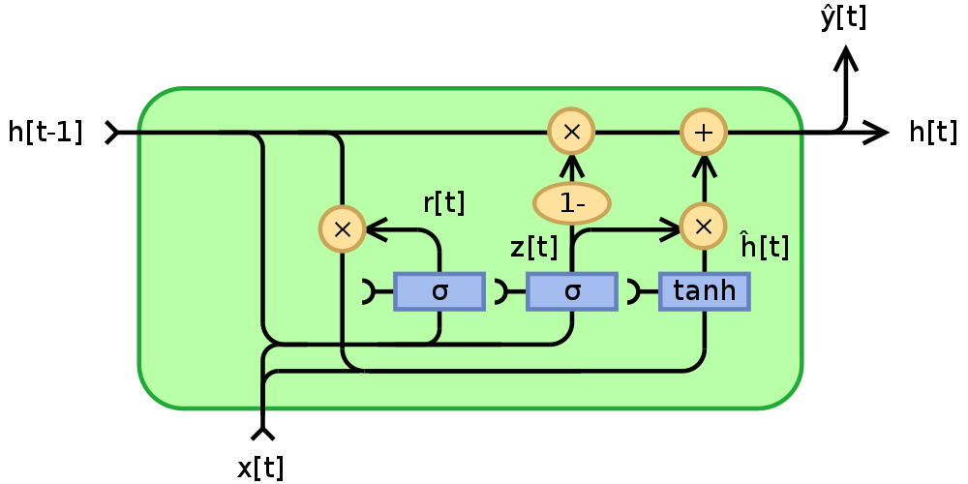
RNN Architectures – GC-GRU & GC-LSTM
Place convolution directly into GRU cell
Convolve signal $X^{t}$and hidden state $H^{t−1}$with learnable kernels $Θ_{r}, Θ_{u}, Θ_{C}$
Alternatively: apply the same principle to LSTM cells
https://commons.wikimedia.org/wiki/File:Gated_Recurrent_Unit,_base_type.svg
Yaguang Li, Rose Yu, Cyrus Shahabi, Yan Liu, Diffusion Convolutional Recurrent Neural Network: Data-Driven Traffic Forecasting, ICLR 2018.

Slide 21
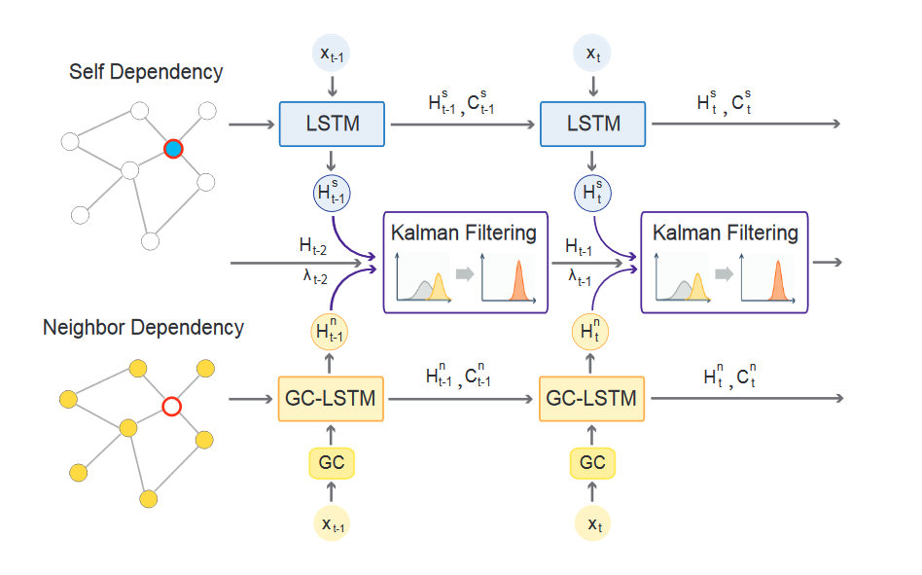
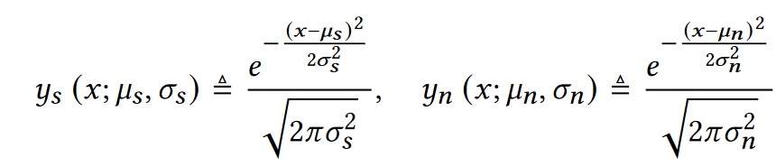
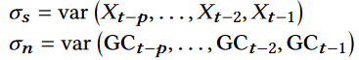
GCNs with Kalman Filtering for Traffic Prediction
Observation
Empirical Variance
Chen, Fanglan, et al. "Graph Convolutional Networks with Kalman Filtering for Traffic Prediction." Proceedings of the 28th International Conference on Advances in Geographic Information Systems. 2020.

Slide 22
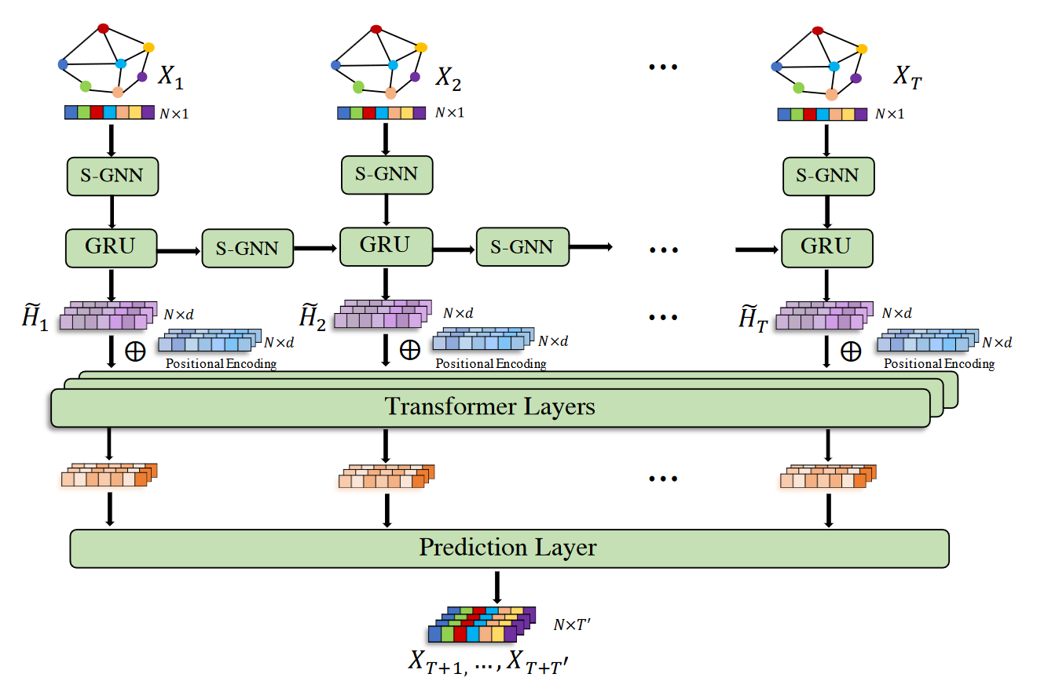
Spatial Temporal Graph Neural Network
Convolutional layer to capture spatial relations
GRU to capture local time
Transformer on top to capture long range dependencies
Prediction Layer which gives the Output Signal
→ Convolution outside of GRU cell
Wang, Xiaoyang, et al. "Traffic Flow Prediction via Spatial Temporal Graph Neural Network." Proceedings of The Web Conference 2020.

Slide 23
Graph Spectral Networks

Slide 24
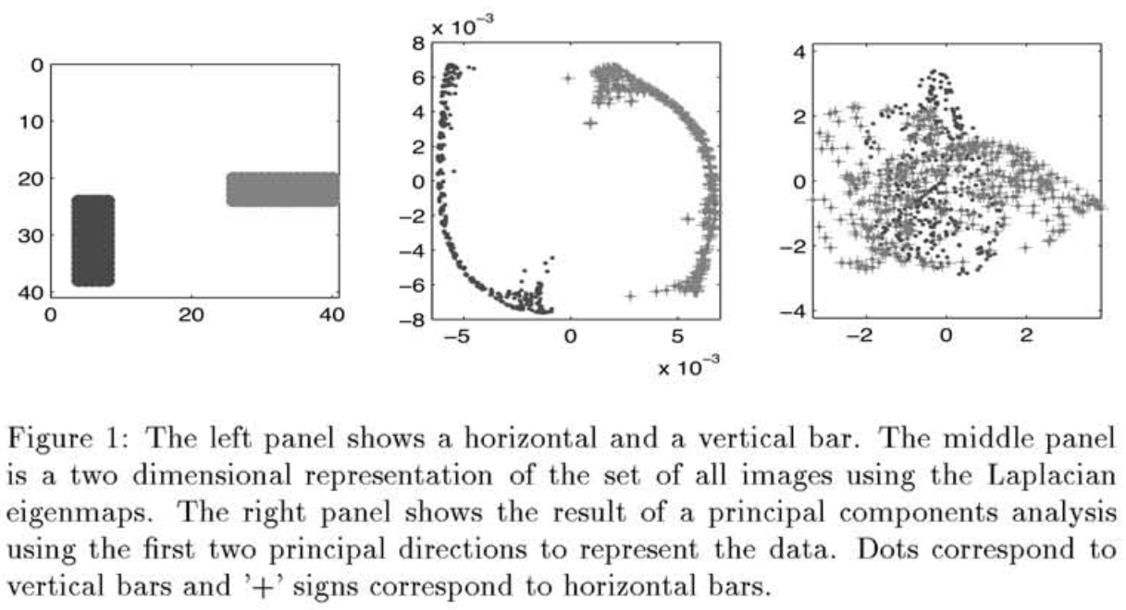
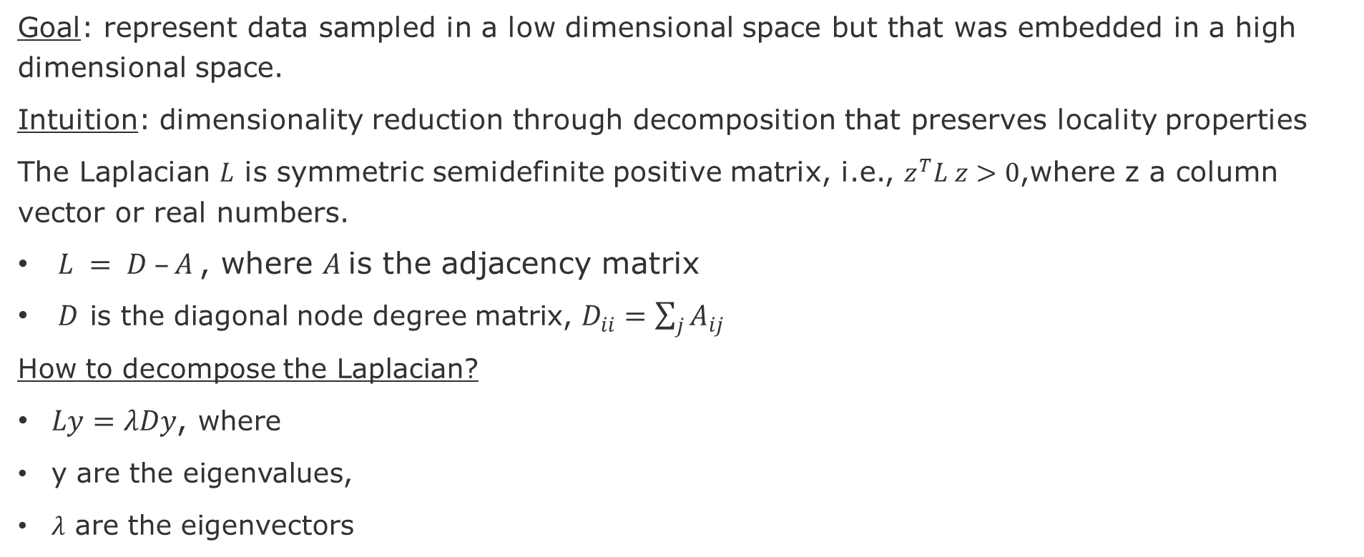
Laplacian Eigenmaps and Spectral Techniques [Belkin & Niyogi 2001]
Goal: represent data sampled in a low dimensional space but that was embedded in a high dimensional space.
Intuition: dimensionality reduction through decomposition that preserves locality properties
The Laplacian $L$ is symmetric semidefinite positive matrix, i.e., $z^{T}L z>0$,where z a column vector or real numbers.
$L = D –A$, where $A$is the adjacency matrix
$D$ is the diagonal node degree matrix, $D_{ii}=\sum_{j}{A_{ij}}$
How to decompose the Laplacian?
$Ly=λDy$, where
y are the eigenvalues,
$λ$ are the eigenvectors
Classification using the Laplacian versus PCA
However, this might be too expensive to large matrices
source: Belkin, M., & Niyogi, P. (2001). Laplacian eigenmaps and spectral techniques for embedding and clustering, NeurIPs, 14, 585-591.
Notes:
PCA = principal component analysis
Symmetric means that Matrix A == Transpose(Matrix M)
Laplacian is symmetric semidefinite positive matrix. You can think of it as an operator on functions defined by the graph G.
https://en.wikipedia.org/wiki/Definite_symmetric_matrix

Slide 25
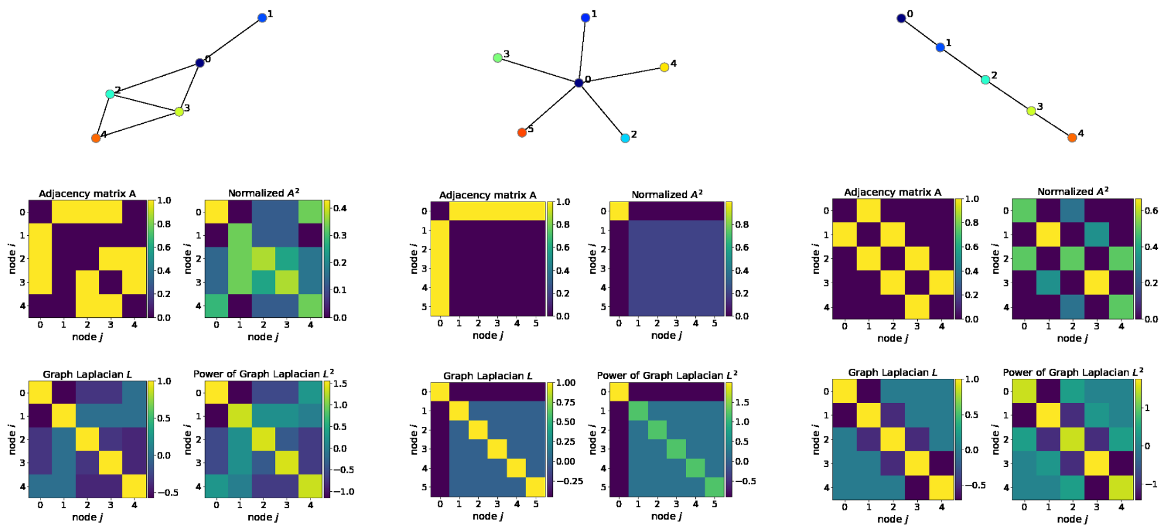
Graph Laplacian visualization [Knyazev 2019]
The Graph Laplacian L is an adjacency matrix A normalized (${L=I − \tilde{D}}^{−\frac{1}{2}}∗A∗{\tilde{D}}^{−\frac{1}{2}}$)
The eigen-decomposition ($L=U Λ U^{T}$) is a graph representation with orthogonal components
Graph Laplacian shows the directions and how smoothly the “energy” will diffuse over a graph if we put some “potential” in node i.
A typical use-case of is to solve how a signal (wave) propagates in a dynamic system.
source: [Knyazev 2019] Boris Knyazev, Spectral Graph Convolution Explained and Implemented Step By Step
https://towardsdatascience.com/spectral-graph-convolution-explained-and-implemented-step-by-step-2e495b57f801
Notes:
graph Laplacian shows in what directions and how smoothly the “energy” will diffuse over a graph if we put some “potential” in node i. A typical use-case of Laplacian in mathematics and physics is to solve how a signal (wave) propagates in a dynamic system.
Eigen-decomposition of the graph Laplacian is applied to a single graph for the purpose to extract subgraphs or clusters (communities) of nodes, and eigenvalues tell us a lot about graph connectivity.
For example, imagine that the star graph above in the middle is made from metal, so that it transfers heat well. Then, if we start to heat up node 0 (dark blue), this heat will propagate to other nodes in a way defined by the Laplacian. In the particular case of a star graph with all edges equal, heat will spread uniformly to all other nodes, which is not true for other graphs due to their structure.

Slide 26
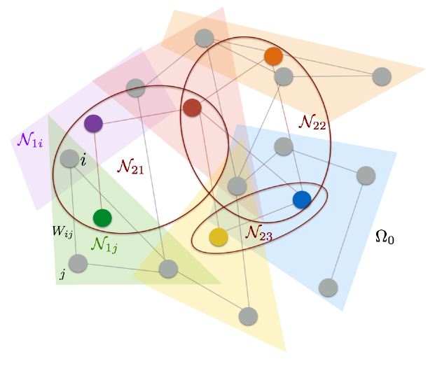
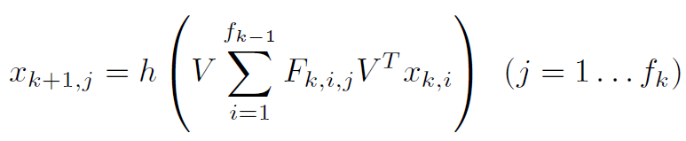
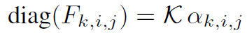
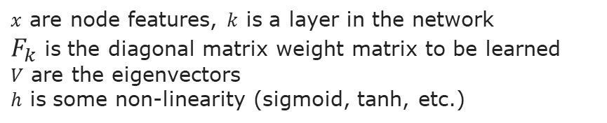
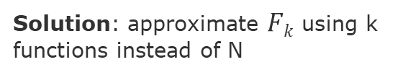
Spectral Networks [Bruna et al. 2014]
Goal: How to efficiently enable convolution over multi-dimensional spaces
Intuition: Obtain an architecture that enables a construction where the number of parameters is independent of the input dimension.
1- Spatial Construction
Locality and Multi-Resolution Clustering
2- Spectral Construction
Graph Laplacian operator (harmonic analysis on the graphs)
Convolution via the Laplacian Spectrum
Multi-resolution
Solution: approximate $Fk$ using k functions instead of N
However, F_{k} depends on the number of nodes and the graph structure
$x$ are node features, $k$ is a layer in the network
$F_{k}$ is the diagonal matrix weight matrix to be learned
$V$ are the eigenvectors
$h$ is some non-linearity (sigmoid, tanh, etc.)
source: Bruna et al., Spectral Networks and Deep Locally Connected Networks on Graphs, ICLR, 2014.
Notes:
Spectral Networks and Deep Locally Connected Networks on Graphs [Bruna et al. 2013]
Bruna et al. 2013 were the first to apply spectral graph analysis to learn convolutional filters for the graph classification problem.
the dimensionality of trainable weights (filters) F_{k} depends on the number of nodes N in a graph;
F_{k} also depends on the graph structure encoded in eigenvectors V.

Slide 27
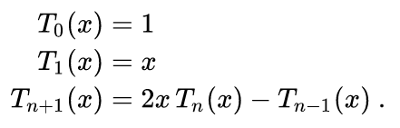
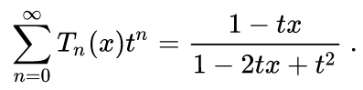
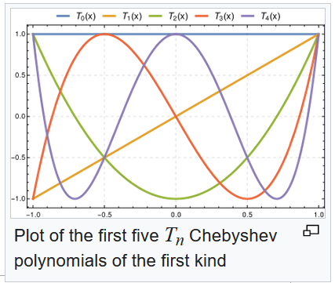
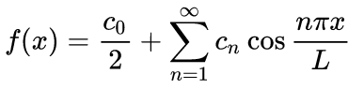
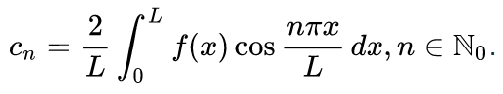
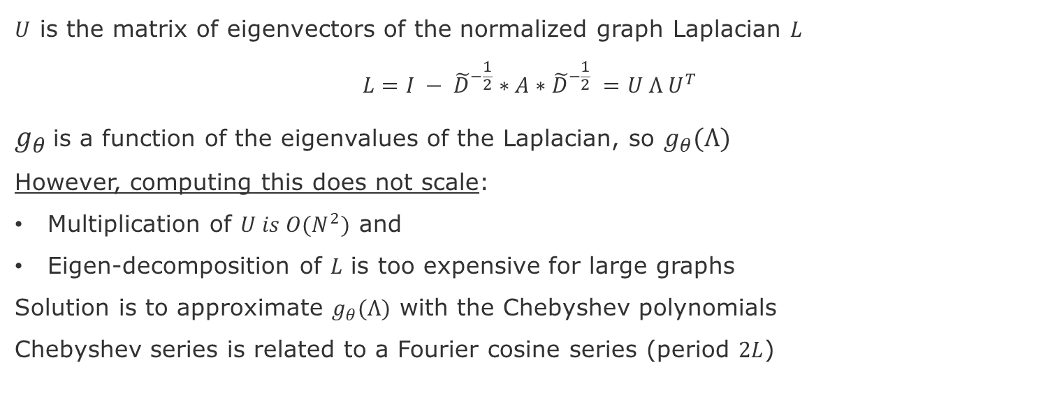
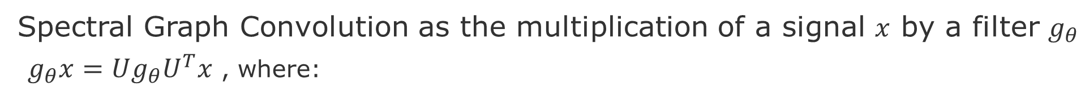
Spectral Graph Convolutions [Kipf & Welling 2017]
Spectral Graph Convolution as the multiplication of a signal $x$ by a filter $g_{θ}$
$g_{θ}x=Ug_{θ}U^{T}x$ , where:
$U$ is the matrix of eigenvectors of the normalized graph Laplacian $L$
$${L=I − \tilde{D}}^{−\frac{1}{2}}∗A∗{\tilde{D}}^{−\frac{1}{2}} =U Λ U^{T}$$
$g_{θ}$is a function of the eigenvalues of the Laplacian, so $g_{θ}(Λ)$
However, computing this does not scale:
Multiplication of $U is O(N^{2})$ and
Eigen-decomposition of $L$ is too expensive for large graphs
Solution is to approximate $g_{θ}(Λ)$ with the Chebyshev polynomials
Chebyshev series is related to a Fourier cosine series (period $2L$)
Wikipedia
source: Kipf, T. N. & Welling, M., "Semi-supervised classification with graph convolutional networks." ICRL, 2017

Slide 28
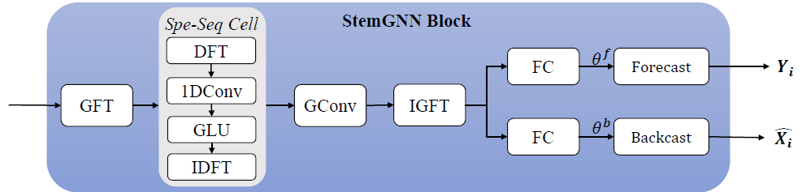
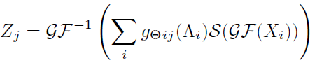
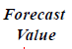
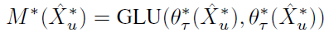
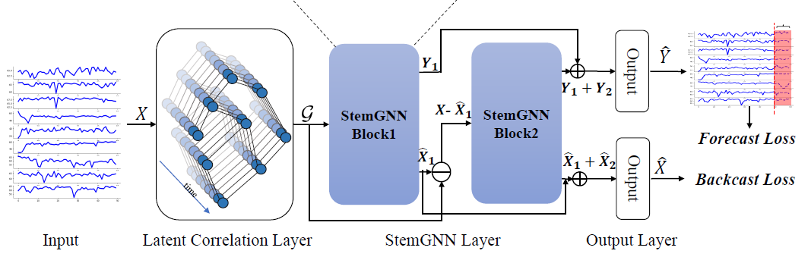
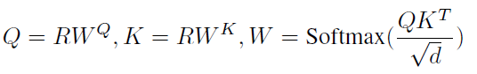

Spectral Temporal Graph Neural Network for Multivariate Time-series Forecasting
Goal: model the intra-series temporal patterns and inter-series correlations jointly
Graph Fourier Transform (GFT) (inter-series relationships)
Discrete Fourier Transform (DFT)
(intra-series correlations)
Latent Correlation Layer
(self-attention mechanism)
Loss Function ($B$=backcasting over K timestamps)
source: Cao, Defu, et al. "Spectral Temporal Graph Neural Network for Multivariate Time-series Forecasting." NeurIPS, 33 (2020).
Notes:
Cao, Defu, et al. "Spectral Temporal Graph Neural Network for Multivariate Time-series Forecasting." NeurIPS, 33 (2020).
Theta is the the
S is an encoder-decoder model
Circle dot is the Hadamard product (also known as the element-wise product) - https://en.wikipedia.org/wiki/Hadamard_product_(matrices)
We have two branches of this module in the StemGNN block, one to forecast future values, namely forecasting branch
The other to reconstruct history values, namely backcasting branch
Recall that Time Series Forecasting has traditional methods like
Garch and Granger Causality

Slide 29
Temporal Evolution

Slide 30


EvolveGraph: Multi-agent trajectory prediction w/ dynamic relational reasoning
Goal: Predict trajectories of multiple interacting agents
Approach: Capture and dynamically update a latent graph of agents’ interactions
C: context information
G_{ß} : denotes the latent interaction graph
H_{i}: Recurrent Unit
G’_{ß} : adjusted interaction graph
T_{h} and T_{f} : forecasting horizons
Loss Functions
Latent interaction graph is inferred at each time step
by a factorization
Li, Jiachen, et al. (2020) "Evolvegraph: Multi-agent trajectory prediction with dynamic relational reasoning," NeurIPS.
Notes:
Li, Jiachen, et al. "Evolvegraph: Multi-agent trajectory prediction with dynamic relational reasoning." Proceedings of the Neural Information Processing Systems (NeurIPS) (2020)

Slide 31
Suggested Readings on Temporal Graph Networks
Bronstein, M., Graph ML at Twitter, 2020 https://blog.twitter.com/engineering/en_us/topics/insights/2020/graph-ml-at-twitter.html
Kazemi, et al., Representation learning for dynamic graphs: A survey. JMLR, 21(70), 2020.
Knyazev, B., Spectral Graph Convolution Explained and Implemented Step By Step https://towardsdatascience.com/spectral-graph-convolution-explained-and-implemented-step-by-step-2e495b57f801
Girault,B., https://www.benjamin-girault.com/pages/graph_transform_visualization.html
Dan Spielman, Course on Spectral Graph Theory, Yale, 2015 - http://www.cs.yale.edu/homes/spielman/561/
Cao, D., et al., Spectral Temporal Graph Neural Network for Multivariate Time-series Forecasting, NeurIPS, 2020.
Bruna, et al., Spectral Networks and Deep Locally Connected Networks on Graphs, ICLR, 2014.
Kipf, T. N. & Welling, M., Semi-supervised classification with graph convolutional networks, ICRL, 2017.
Rossi, et al., Temporal Graph Neural Networks, NeurIPS, 2020.
Wang, X., et al., Traffic Flow Prediction via Spatial Temporal Graph Neural Network, Proceedings of The Web Conference, 2020.
Chen, Fanglan, et al., Graph Convolutional Networks with Kalman Filtering for Traffic Prediction, ICAGIS, 2020
Qiu, Z., et al., Learning spatio-temporal representation with pseudo-3d residual networks, IEEE ICCV, 2017.
D. Tran, et al., "Learning Spatiotemporal Features with 3D Convolutional Networks," IEEE ICCV, 2015.
Yu, B., et al., 3d graph convolutional networks with temporal graphs: A spatial information free framework for traffic forecasting, 2019.
Daniel Spielman. Spectral graph theory. In Combinatorial scientific computing, Nr. (18), Citeseer, 2012.
Bogdan Nica. A brief introduction to spectral graph theory. In arXiv preprint arXiv:1609.08072, 2016.
Defferrard, M., et al., Convolutional neural networks on graphs with fast localized spectral filtering. NeurIPS, 2016.
Ortega, A., et al., Graph signal processing: Overview, challenges, and applications. IEEE, Vol. 106(5):808--828, 2018.

Slide 32
Next and Future Tasks
Compute and compare graph metrics (Wednesday, 2.12)
First draft of abstract (Friday, 4.12)
Predictions using traditional method (Wednesday, 9.12)
Related work draft (Friday, 11.12)
Node and Graph Feature Learning (Wednesday, 16.12)
Design alternative pipelines for your GNN (Wednesday, 06.01)
Three alternative with different options for embedding, aggregation, and encoding
Test at least one.
Execute pipeline for different configurations (will be scheduled individually)
Sensitivity Analysis
Ablation study

Slide 33
END

